Slide 1





Agricultural Water Requirement Analysis
Student Details
Name: Dashanthika Thandesh
NM Id: au2021109006
College Name: College of Engineering,Guindy

Slide 2

Project Outline:
Abstract
Problem Statement
Aims, Objective & Proposed System/Solution
System Deployment Approach
Model Development & Algorithm
Future Scope
Video of the Project
Conclusion
Reference

Slide 3

Abstract
The agriculture sector plays a vital role in economic growth and sustainable development in agricultural countries.
Current mass consumption and production patterns have led to an unsustainable use of natural resources,
including freshwater, which is one of the most crucial natural resources for people and the planet. Agricultural production systems are alone responsible for 72 percent of all global water withdrawals.

Slide 4

Problem Statement
As we are moving towards a sustainable approach of development, the conservation of water and limited (i.e) required amount of water must be used
Develop a system for the exact water requirement for the particular crop and according to the weather the water usage is restricted.

Slide 5

Aim and Objective
Aim: The primary objective of this Final Seminar is to present the outcomes made in the project
“Analysis on Water requirement in
agiculture”

Slide 6

Objectives
Precise Analysis: Delivers the exact amount of the required amount of water
Real-time Processing Optimization: Optimize the solution for real-time processing, minimizing latency while maintaining high accuracy
Robustness to Variability: Enhance the system's robustness to variations in weather conditions, crop quality.
User Interface Integration: Develop a user-friendly interface for seamless interaction with the system.
Scalability and Adaptability: Design the system to be scalable and adaptable to different
hardware configurations for broader applicability.

Slide 7
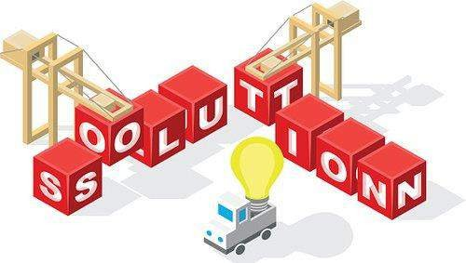
Proposed Solution
Solution: The project involves utilization of Random Forest Regressor(RFRs) for analysis.
Integration of pre-trained analysing
models based on RFR architectures.
Implementation of efficient data preprocessing techniques for enhanced performance.
Deployment of optimized model architectures for processing on resource- constrained devices.

Slide 8
System Deployment Approach
Pre-Processing and Crop Identification
Appropriate
selection
INPUT
OUTPUT

Slide 9
Model Development & Algorithm
Dataset Description:
The data set contains the water requirement of different crops
Size of dataset is about 2800
Categorised into six divisions

Slide 10
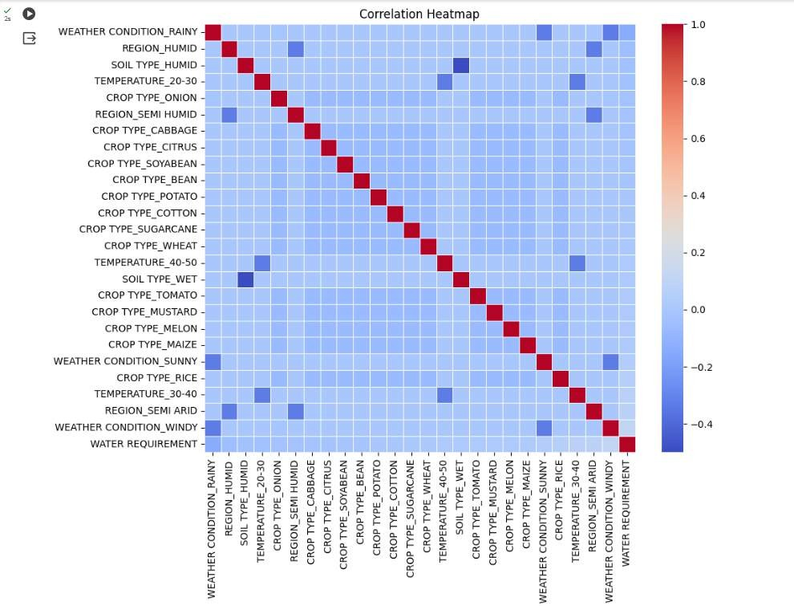
RESULT: Correlation using Heatmap

Slide 11
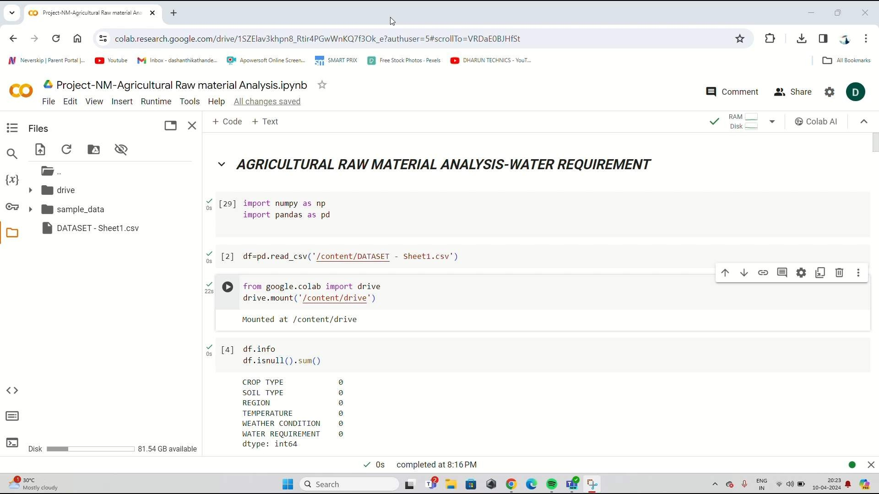
OUTCOME: Video

Slide 12

Conclusion
Our project represents a significant advancement in requirement recognition.
By considering both weather and crop the system results in appropriate solution.
Leveraging cutting-edge AI/ML techniques and innovative system design, our goal is to create a versatile and efficient system for personalized
user experiences across various domains and applications

Slide 13

Reference:
https://scikitlearn.org/stable/modules
/generated/sklearn.ensemble.Random ForestRegressor.html
https://kth.divaportal.org/smash/get/ diva2:1681698/FULLTEXT01.pdf
https://www.mdpi.com/2073- 4441/11/9/1758
https://www.hindawi.com/journals/js/ 2022/3438943/

Slide 14


